Slide 1
Chap 7 – Data Modeling Entity Relationship Diagram (ERD)

Slide 2
Learning Objectives
Identify entities and relationships from a simple narrative
Draw ERDs to show relationships between entities

Slide 3
Main Deliverables & Outcomes
ERDs produced during Analysis phase:
ERD for current system
ERD for new system
Covers just data needed in the project’s application
Remember that the priority is always to produce models of the new system
Notes:
ERD current system: for the whole database from which data, for the application system being replaced, is drawn
ERD new system: for the whole database from which the new application’s data are extracted

Slide 4
Other Deliverables & Outcomes
A set of entries about data objects to be stored in the data dictionary and repository
Repository links data, process and logic models of a computer-based system
Data elements that are included in the DFD must appear in the data model and visa versa
Each data store in a process model must relate to business objects represented in the data model

Slide 5
THE ENTITY-RELATIONSHIP DIAGRAM (ERD)
An entity-relationship diagram (ERD) is a picture showing the information that is created, stored, and used by a business system.
Entities lists similar kinds of information
Lines drawn between entities represent relationships among the data.
Special symbols communicate high-level business rules.

Slide 6
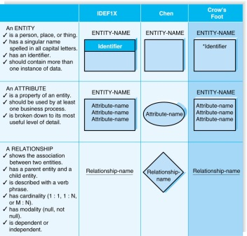
Elements of an Entity Relationship Diagram
We will use Crow’s Foot Notation

Slide 7
Videos Links
Entity Relationship Diagram (ERD) Training Video
https://youtu.be/-fQ-bRllhXc
Entity Relationship Diagram (ERD) Tutorial
– Part 1 & Part 2
https://www.youtube.com/watch?v=QpdhBUYk7Kk
https://www.youtube.com/watch?v=-CuY5ADwn24

Slide 8
CREATING AN ENTITY RELATIONSHIP DIAGRAM (ERD)
Drawing the ERD is an iterative process of trial and revision.
The basic steps in building an ERD:
1. Identify the entities;
2. add the appropriate attributes to each entity; and
3. draw relationships among entities.

Slide 9
Step 1: Identify the Entities
The entities should represent the major categories of information that you need to store in your system.
If you begin the data model using a use case, look at the major inputs and outputs of the use case.
If the process models are available, look at the data stores, external entities, and data flows.

Slide 10
Step 2: Add Attributes and Assign Identifiers
The information that describes each entity becomes its attributes.
One or more of the attributes will become the entity’s identifier.

Slide 11
Step3: Identify Relationships
The last step in creating ERDs is to determine how the entities are related to each other.
Lines are drawn between the entities that have relationships.
Each relationship is labeled, and cardinality and modality are assigned.

Slide 12
ENTITIES
Entity
An entity is a business object or thing we want to store and process information about.
Entities can be grouped into one of 5 classes: persons, places, objects, events or concepts
Nouns refer to entities
Entities are described by attributes
Entity Occurrences/instances
Entities represent something for which there exist multiple instances, or occurrences
Each set of values for the attributes represents an occurrence of an entity
ENTITY NAME
Examples
STUDENT, CUSTOMER, DOCTOR, ESTIMATE, DVD, LOAN, ORDER, ORDER-LINE, STOCK ITEM, RESERVATION
Notes:
An entity is also referred to as a type
An occurrence is also referred to as a tuple

Slide 13
ATTRIBUTES
An attribute is a descriptive property or characteristic of an entity
e.g. For entity STUDENT we have such attributes as NAME, ADDRESS, DATE OF BIRTH etc
Synonyms : element, column, field, variable
A compound attribute is actually one that consists of other attributes
e.g. for entity STUDENT, a student’s NAME is actually a compound attribute that consists of FIRST NAME, SURNAME and MIDDLE INITIAL
Synonyms : composite attribute, concatenated attribute and data structure

Slide 14
Different Views of an Entity with Attributes
Table : Module Enrolment
#Result
Code
*Student
Number
*Module
Code
Grade
Point
MODULE ENROLMENT
*Student Number
*Module Code
Grade Point
#Result Code
CC1001
CMA113
79
P
Each row is known as either an entity instance, tuple, record, or an occurrence
CC1001
CIS101
60
P
CC1002
CMA113
33
F
CC1002
CIS101
20
F
CC1003
CCT103
99
P
CC1003
CCM118
99
P
Module Enrolment(*Student Number, *Module Code, Grade Point, #Result Code)
Notes:
Explicitly state what an occurrence table is

Slide 15
Student Activity #1
In groups of two or three:
Give an example for 2 of the 5 possible entity types.
Persons
Places
Objects
Events
Concepts
Define a two suitable attributes for each entity example.

Slide 16
Functional Dependency
‘Given a relation R, the attribute B is said to be functionally dependent on attribute A if at every instant in time each value of A has no more than one value of B associated with it in the relation R’
(Cardenas, 1985)
If we know your student number we can find your name, associated address, telephone no etc.
Notes:
A core concept of data modelling is functional dependency or determinacy

Slide 17
Keys Attributes (a.k.a Key Identifiers)
An attribute, or group of attributes, that assumes a unique value for each entity instance
Identifies a specific instance of an entity
Considered relation variables as they determine the value of other attributes
A group of attributes that uniquely identify an instance of an entity is referred to as a compound, composite or concatenated key
Example #1
Example #2
Title
Location
Film No
Film No
Year
Status
Copy No
Actor
Supplier No
Notes:
We need both pieces of data to identify a specific tape e.g. copy #3 of The Minority Report

Slide 18
Primary Key Attributes
An attribute, or group of attributes, that assumes a unique value for each instance of the entity in which it functions
Determinants
Example
Location
*Film
No
*Copy
No
Status
#Supplier
No
Film No
Location
Status
F01
01
A3S1
L
S01
Copy No
F01
05
A3S2
A
S08
Supplier No
Notes:
We need both pieces of data to identify a specific tape e.g. copy #3 of The Minority Report

Slide 19
Student Activity #2
In groups of two or three:
Identify suitable primary key attributes for the entities you defined in the previous activity

Slide 20
Relating Entities with Foreign Key Attributes
An attribute, or group of attributes, within an entity that functions as a primary key attribute in another entity
Serves to relate or link entities and fundamental to the relational data model
Entity Relationship Diagram: a view at Entity level
STUDENT
COURSE
*Student Number
Name
Address
#Course Code
0..M
1
*Course Code
Course Name
is registered on
has
Notes:
HIGH LEVEL STRUCTURAL VIEW - NO ATTRIBUTE VALUES SHOWN THEREFORE NO SPECIFIC INSTANCES (WE NEED TABLE VIEW FOR THAT)

Slide 21
Relating Entities with Foreign Key Attributes
Tables (or Relations): a view at attribute and occurrence level
Table : Student
Table : Course
*Student
Number
#Course
Code
*Course
Code
Name
Address
Course Name
CC1001
Bill Gates
79, East St
C001
C001
BSc Computing
CC1002
Bob Door
60, West St
C001
C002
BSc Info Sys
CC1003
Jane Smith
33, North St
C002
CC1004
Rita Hoe
20, High St
C002
CC1005
Jim Lowe
99, New St
C001
CC1006
Don Duck
99, Old St
C002

Slide 22
Student Activity #3
In groups of two or three:
Draw a table view of the following entity relationship diagram
STAFF
Is attached to
BRANCH
*Staff Number
Name
Salary
#Branch Code
1..M
1
*Branch Code
Branch Location
has

Slide 23
Compound and Composite Keys
Compound/composite/concatenate keys indicate that two or more tables have been linked
Each element in a compound key relates to a primary key in another table
Student Number + Module Code
Not every element in a composite key relates to a primary key in another table
Film No + Copy Number

Slide 24
Candidate Key Identifiers
There may be more than one attribute that could be used to uniquely identify an instance of an entity
e.g. You could identify an individual student by their National Insurance Number or Passport number
A candidate key is a ‘candidate to become a primary key’ of instances of an entity
Could be a single attribute or a collection of attributes (compound key)

Slide 25
RELATIONSHIPS
Relationships are associations between entities.
Every relationship has a parent entity and a child entity.
Relationships should be labeled with active verbs.

Slide 26
Cardinality and Modality
Cardinality and Modality are the indicators of the business rules around a relationship.
Cardinality refers to the maximum number of times an instance in one entity can be associated with instances in the related entity.
Modality/Optionality refers to the minimum number of times an instance in one entity can be associated with an instance in the related entity.

Slide 27
Cardinality
A relationship has cardinality which is the ratio of parent instances to child instances.
The 1:1 relationship means that one instance of the parent entity is associated with one instance of the child entity.
The 1:N relationship means that a single instance of a parent entity is associated with many instances of a child entity.
The M:N relationship means that many instances of a parent entity can relate to many instances of a child entity.

Slide 28
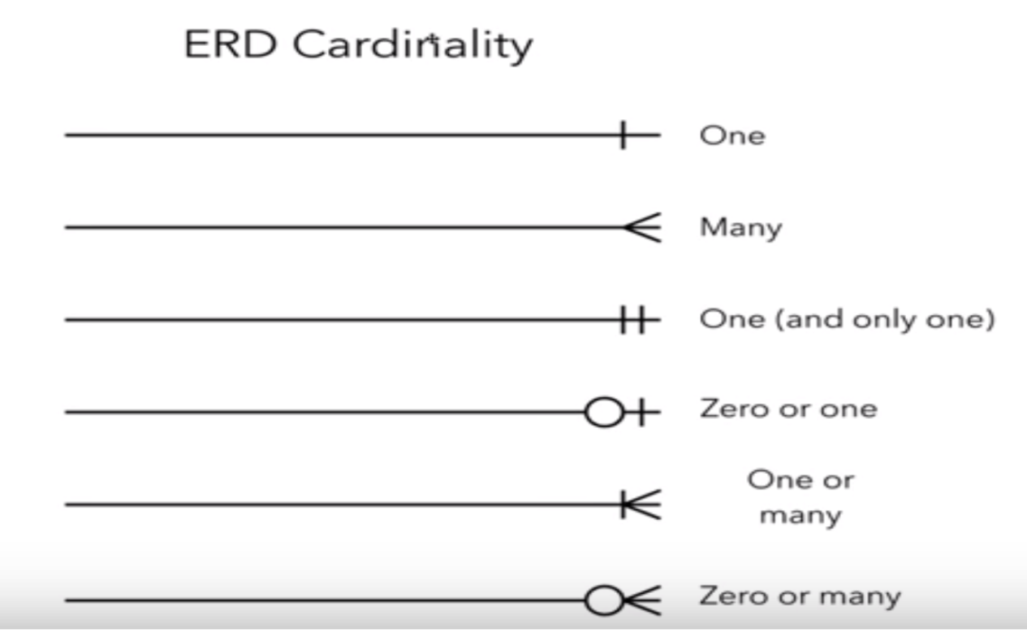
Cardinality (Cont.)

Slide 29
Modality/Optionality
Some relationships are mandatory and some are optional
Minimum and maximum cardinality must be specified
Zero or more (optional)
Exactly one (mandatory)
One or more (mandatory)
Zero or one (optional)

Slide 30
Optionality
EMPLOYEE
CUSTOMER
LECTURER
may become
may place
may teach
is
derived from
is placed by
is taught by
UNION MEMBER
ORDER
MODULE

Slide 31
one-to-many (1:n or n:1)
ENTITY x
One instance of an entity is associated with many instances of another entity
‘Crow’s feet’ at one end of relationship line depicts direction of 1:n relationship
n=0 or more (business specific)
1
x is known either as master, owner or parent
0..n
y is correspondingly known either as details, owned or child
ENTITY y

Slide 32
one-to-many (1:n or n:1)
SCHOOL
CUSTOMER
BORROWER
has
place
request
attends
is placed by
is requested by
CHILD
ORDER
LOAN

Slide 33
one-to-one (1:1)
ENTITY X
One instance of an entity is associated with one instance of another entity
Rare
1
1
ENTITY Y

Slide 34
one-to-one (1:1)
ESTIMATE
HUSBAND
become
is married to
is
derived from
is married to
ORDER
WIFE

Slide 35
Implementing Entity Relationships: Tables & Foreign Keys
Child (y)
Parent (x)
Entity : Student
Entity : Course
STUDENT
COURSE
*Student
Number
Student
Name
#Course
Code
*Course
Code
Course
Title
*Student Number
Student Name
#Course Code
*Course Code
Course Title
CC1001
Joe Bloggs
BScL01
BScL01
Computing
CC1002
Tim Dim
BScL01
BScV01
Visualisation
is registered on
has
CC1003
Albert Einstein
BScL01
BScI01
Info. Sys
Student(*Student Number, Student Name, #Course Code)
Course(*Course Code, Course Title)
A foreign key in an entity, y, always matches a primary key in another entity, x, it is merely copied from x (parent) to y (child) to establish a relationship between them.
Notes:
Refer slide 20 for ERD

Slide 36
Student Activity #4
Draw the ERD, with primary key and foreign key for the following entities:
a) - Customer
Order
b) - Borrower
Loan
Can you see how the cardinality is influenced by the keys?
Notes:
Refer to slide 32 for tips

Slide 37
many-to-many (m:n)
ENTITY X
Many instances of an entity are associated with many instances of another entity
Very common when first analysing business data
Such relationships ALWAYS imply that an entity is missing
m
n
ENTITY Y

Slide 38
m:n Relationships Require Link Entities
Scenario
A doctors’ practice has many doctors and a doctor can have appointments with a number of patients. A patient could have an appointment with more than one doctor.
What is missing in the ERD?
A bridge/link table is needed
DOCTOR
may have appt with
may have appt with
PATIENT

Slide 39
Optionality and Link Entities
DOCTOR
Parent/ Master
Doctor
DOCTOR
may supervise
may have appt with
is supervised by
APPOINTMENT
Appointment
Appointment
Child/ Details
may have appt with
is made for
PATIENT
may make
Parent/ Master
PATIENT

Slide 40
Optionality and Link Entities
ORDER
Parent/ Master
Doctor
ORDER
is made up of
may refer to
belongs to
ORDER-LINE
Appointment
Appointment
Child/ Details
may be part of
refers to
STOCK ITEM
may be part of
Parent/ Master
STOCK ITEM

Slide 41
Rules for Link Entities
A many-to-many relationship MUST always be resolved by creating a new link entity
The link entity is joined to each original entity by a 1:m relationship with the ‘many’ (crow’s feet) end attached to the link entity
The cardinality at the parent end of the relationship is usually one and mandatory. The child (link entity) part of the relationship, is commonly optional but optionality depends on the problem domain

Slide 42
Rules for Link Entities (cont.)
The other half of the relationship has the same optionality as in the original many-to-many relationship
If it is difficult to name a link entity between entity x and entity y the just name it x/y Link
Name both ends of the relationship

Slide 43
Student Activity #5
How would you resolve an m:n relationship between EMPLOYEE and PROJECT? Draw the ERD with the Primary Key and Foreign Key.

Slide 44
Exclusive Relationships
An instance of an entity x can be associated with one or more instances of an entity y or one or more instances of an entity z but NOT both (simultaneously)
CUSTOMER
is issued with
is issued with
is despatched to
is despatched to
INVOICE
STATEMENT

Slide 45
Multiple Relationships
We have looked at single binary relationships (one relationship between 2 entities) and a unary relationship
Let’s now consider:
Multiple binary relationships
Simultaneous relationships across three entities (ternary relationships)

Slide 46
Multiple Binary Relationships
LECTURER
may propose
may supervise
must be created by
must be supervised by
PROJECT

Slide 47
Student Activity #7
What would the primary and foreign keys be for LECTURER and PROJECT?

Slide 48
Student Activity #7 (answer)
What would the primary and foreign keys be for Lecturer and Project?
LECTURER
PK Lecturer ID
Lecturer Name
PROJECT
PK Project ID
Project Title
FK Lecturer ID
Tips:
The FK is normally placed at the crow feet end
This will eliminate repetition

Slide 49
Ternary Relationships
DRIVER
issues
TICKET
is for
BUS
is issued by
may sold
is given to
may buy
CUSTOMER
Notes:
Or consider how you would model data relating to the performance of a worker undertaking an operation using a particular tool?

Slide 50
Worked Example
A loan or reservation always begins with a borrower who may decide to either loan a DVD, or if it is unavailable, to make a reservation. Each DVD title in stock is separately categorised according to its subject matter and the starring actor(s)

Slide 51
Worked Example
Identify entities (nouns!)
A loan or reservation always begins with a borrower who may decide to either loan a DVD, or if it is unavailable, to make a reservation. Each DVD title in stock is separately categorised according to its subject matter and the starring actor(s)

Slide 52
Worked Example
SUBJECT
BORROWER
LOAN
RESERVATION
SUBJECT/TITLE
ACTOR
DVD
TITLE
ACTOR/TITLE

Slide 53
The Data Dictionary and Metadata
A data dictionary contains the information about the entities, attributes, and relationships on the ERD, or metadata.
Metadata is data about data.
Metadata is stored in the data dictionary so it can be shared by developers and users throughout the SDLC.

Slide 54
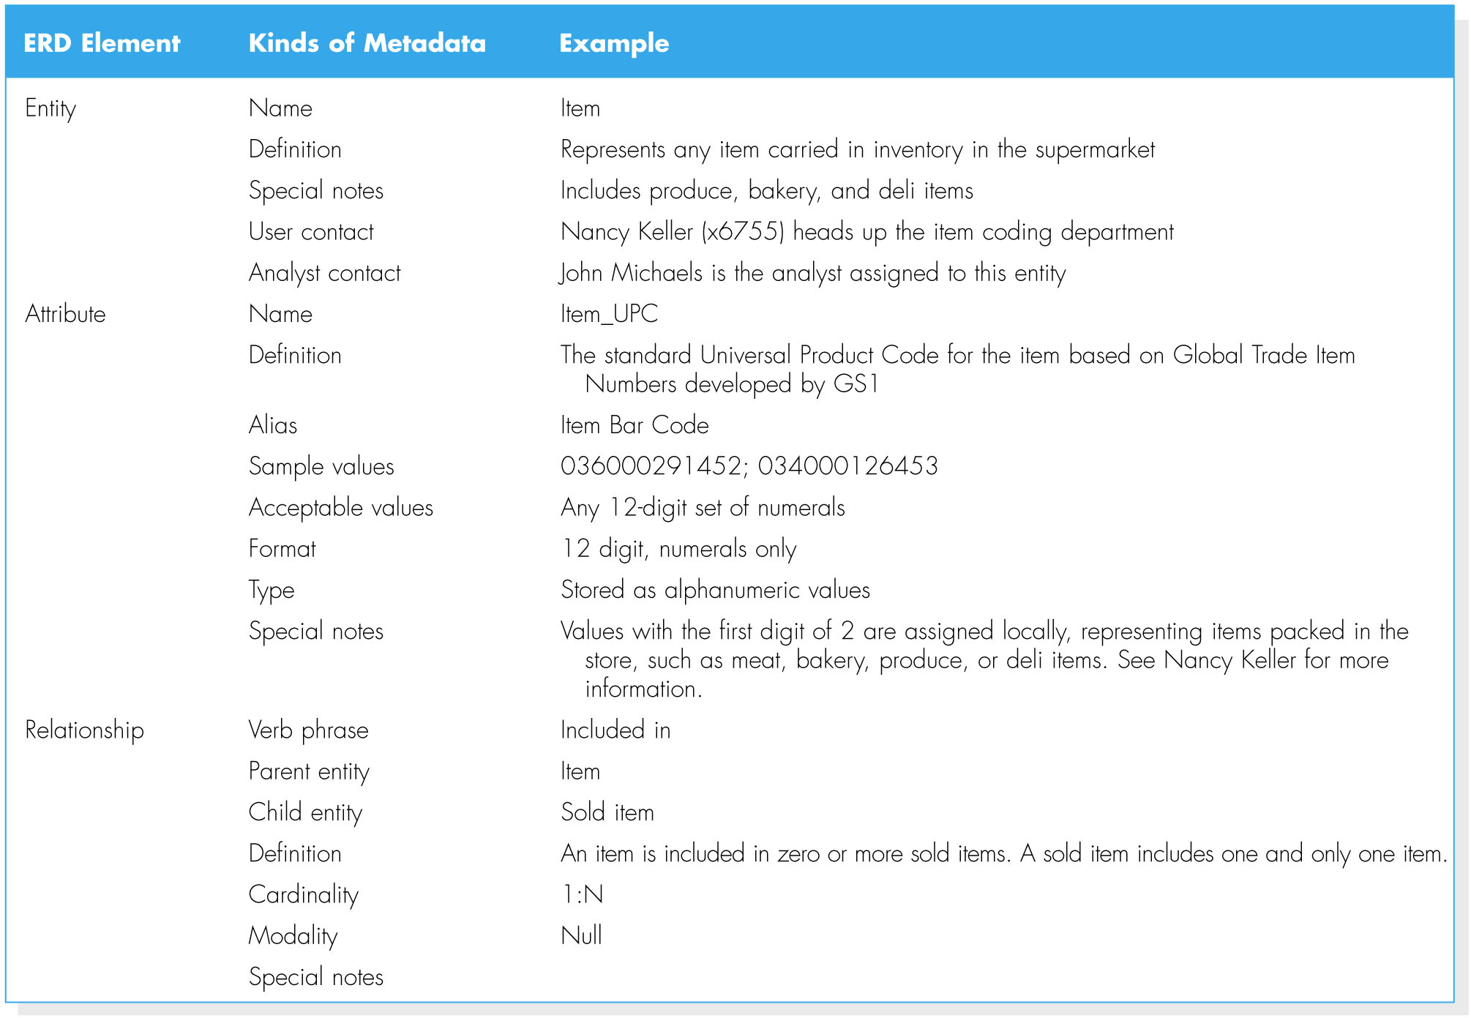
The Data Dictionary and Metadata (cont.)
Types of Metadata Captured by the Data Dictionary

Slide 55


